Slide 1
Tranexamic acid for Acute hemorrhage: A narrative Review of Landmark Studies and a Critical Reappraisal of its use over the last decade
www.anesthesia-analgesia.org
December2019-Volume129-Number 6
R1 Pattiya Puttasinpornskul
A Kritsana Nongnueng

Slide 2
TXA: The Pharmaceutical Agent
The transform of 4-(aminomethyl) cyclohexanecarboxylic acid
Inhibiting effect on fibrinolysis

Slide 3
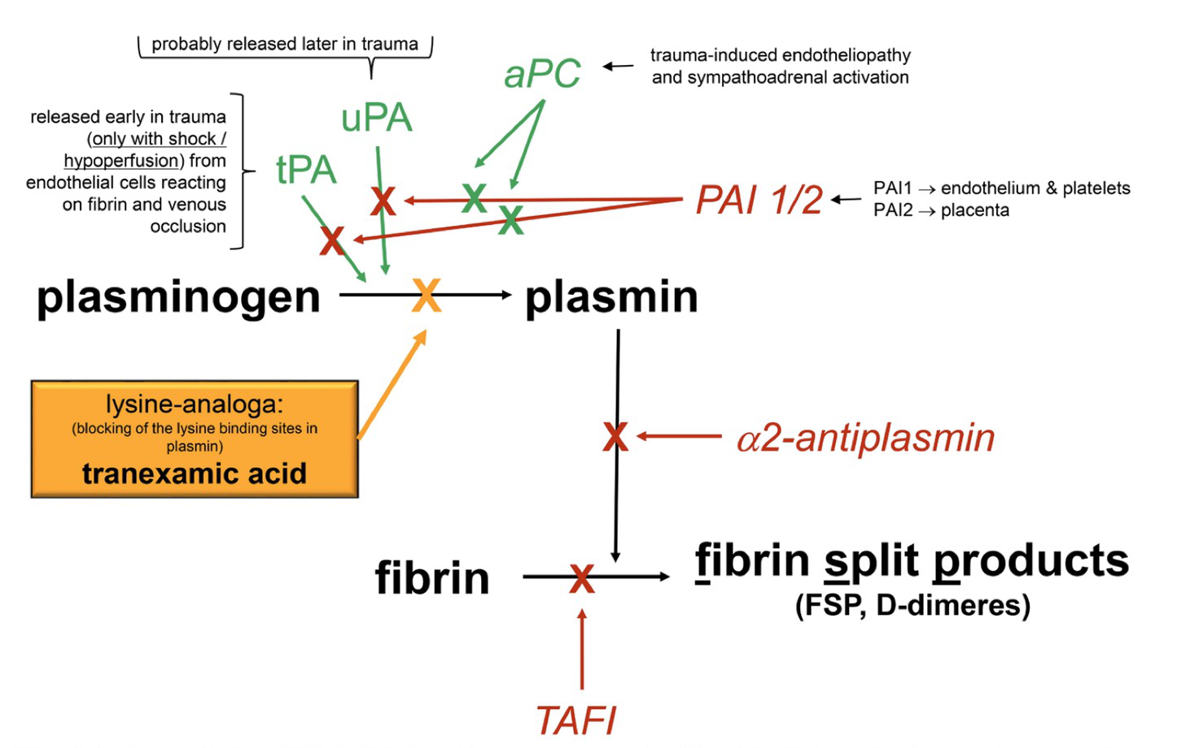

Slide 4
TXA: The Pharmaceutical Agent
Reduce plasmin-mediated release of vasoactive peptides: bradykinin, histamine
Reduce proinflammatory action on the complement system
Plasminogen and plasmin:
-Inflammation
-Angiogenesis
-Chemotaxis
-Tissue remodeling
-Wound healing
Precise mechanism in effects in hemorrhage: unknown

Slide 5
TXA: The Pharmaceutical Agent
Peak plasma concentrations: rapidly after iv infusion
TXA diffuses throughout all tissues
10% in CSF
1% in human milk
TXA: eliminated unchanged via GFR and excretes in urine in 2-3 hours after administration
Antifibrinolytic effects last up to 7-8 hours
After 24 hours,90% of single iv is eliminated

Slide 6
TXA: The Pharmaceutical Agent
The antifibrinolytic effects of TXA were first published in the 1960s
Its primary iv use in cardiac surgery
2008, Treatment of hemorrhagic condition
-Trauma
-Obstetics
-Cardiac surgery
-Liver surgery
-Orthopedic surgery

Slide 7
TXA: The Pharmaceutical Agent
Contraindication
-Hypersensitivity
-Severe renal impairment
-History of convulsion
-Active intravascular clotting
Notes:
TXA: fibrinolysis-induced early increase in d-dimers and plamin-antiplasmin
Esp. Trauma, PPH
TXA : reported seizure
Mech: multifactorial
Dose dependent reduction GABA, reversible block NMDA, rt. Shift glycine concentration-response curve of NMDA-dependents currents

Slide 8
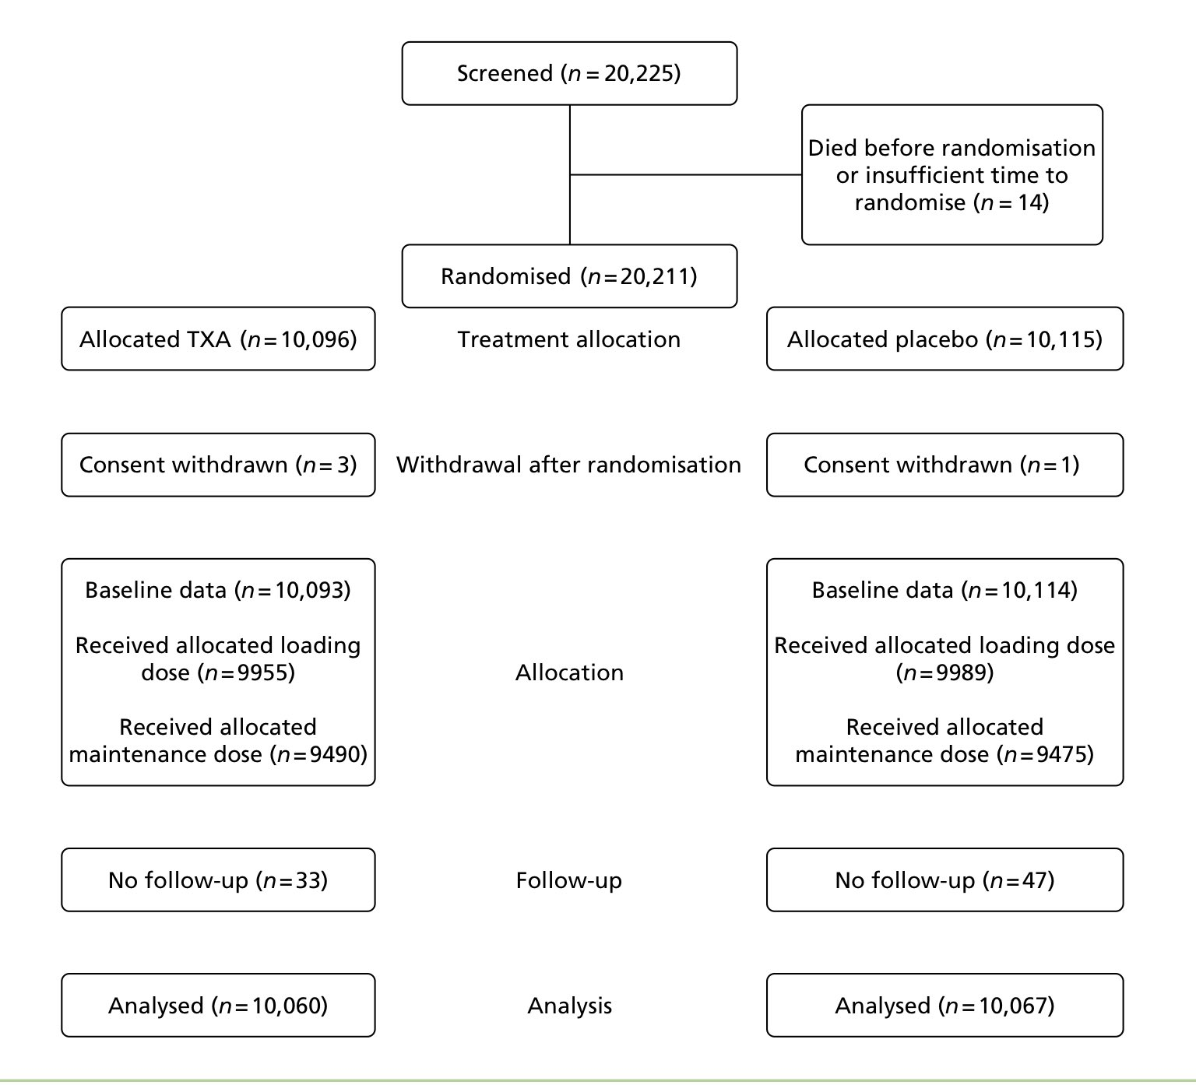
CRASH-2
Notes:
The Clinical Randomization of an Antifibrinolytic in Significant Hemorrhage2
274 รพ. 40 ประเทศ
ให้ยาภายใน 8 ชม หลังอุบัติเหตุ
Loading dose 1g in 10 นาที
Infusion 1 g over 8 h

Slide 9
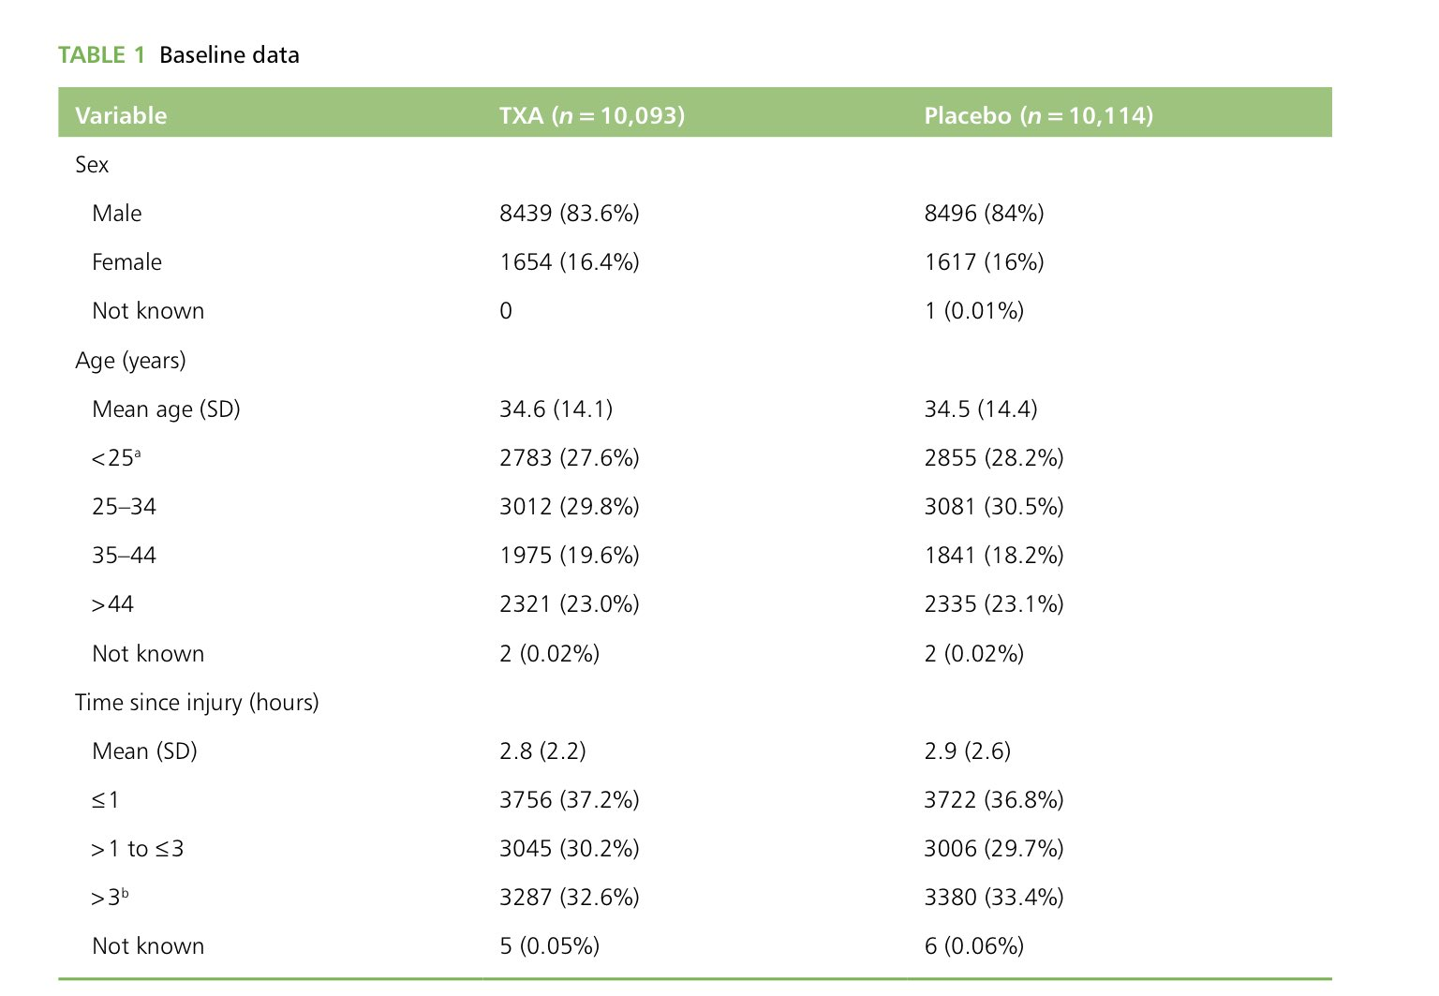
CRASH-2

Slide 10
CRASH-2

Slide 11
CRASH-2

Slide 12
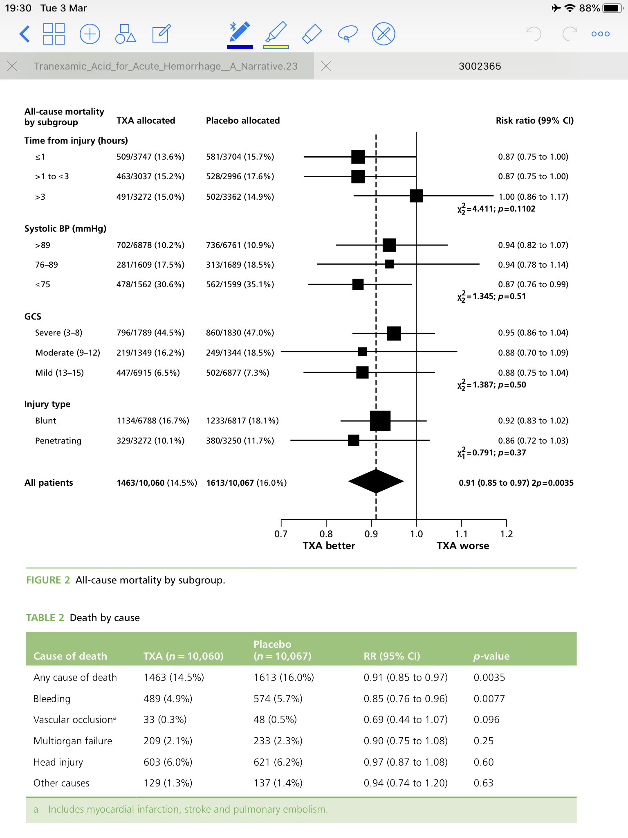

Slide 13
CRASH-2
Notes:
ไม่ลดtransfusion ไม่มีผลกับlab coagulation ไม่จำเพาะกับประวัติshock, injury severity

Slide 14
CRASH-2
Application of TXA within 1 hour after trauma: Largest survival benefit
(ARR= 2.4%, NTT= 41)
Administration of TXA between 1-3 hours also reduced risk of death due to bleeding (ARR= 1.3%, NTT= 77)
TXA given after 3 hours increased the risk of death due to bleeding
Notes:
WHO= essential medicine
Save 70,000-100,000 lives each year

Slide 16
MATTERs
Military Application of TXA in Trauma Emergency Resuscitation Study and Other Follow-up Studies
Bleeding scenarios and patients in shock requiring massive transfusionin both military and civilian setting

Slide 17
MATTERs

Slide 18
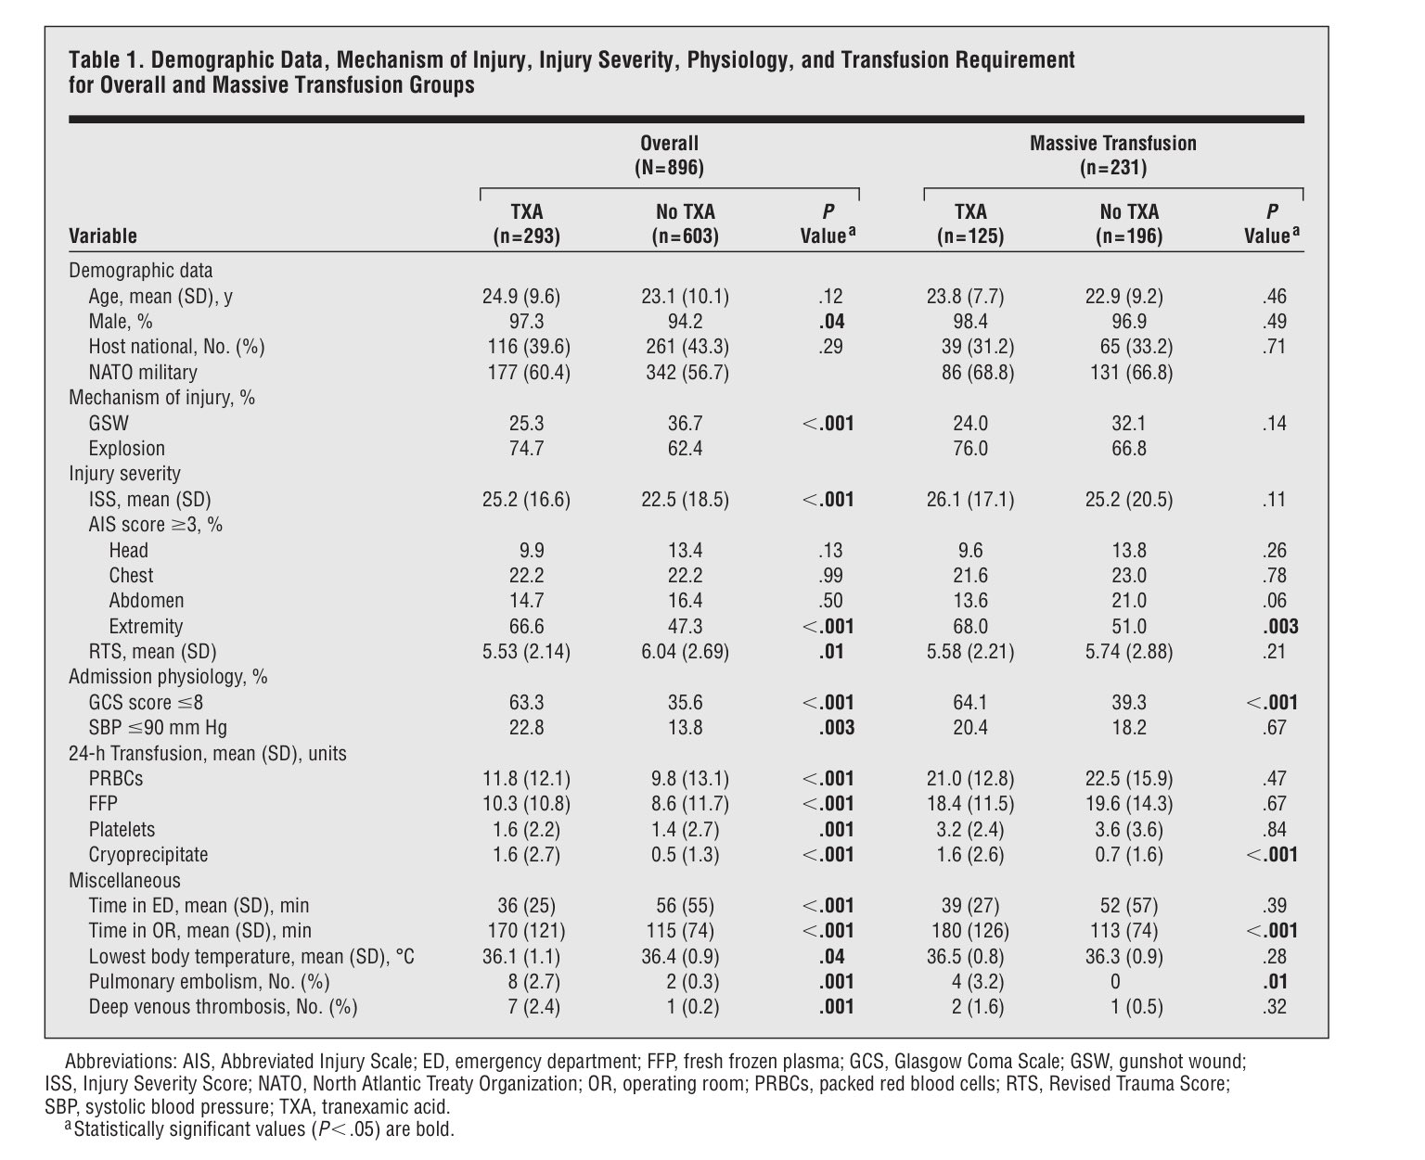

Slide 21
MATTERs
Use TXA to patients with “Excessive bleeding” or those who are “bleeding or at risk of significant hemorrhage as soon as possible within 3 hours of injury”

Slide 22
WOMEN
The World Maternal Antifibrinolytic (WOMAN) trial
PPH

Slide 24
Prehospital Administration of TXA
Positive effect of TXA in prehospital phase of care to trauma patients with sign of hemorrhagic shock
Cal-PAT trial
-Prospective, multicenter, observational and nonrandomized cohort
-Statistically significant decrease in 28-day mortality in favor of early TXA use
-Statistically significant decrease in 28-day mortality observed in patients requiring massive transfusion with > 10 units of blood products
Notes:
Statistically significant decrease in 28-day mortality in favor of early TXA use
(3.8% and 8.3%, absolute mortality reduction 4.7%, NTT =21)
-Statistically significant decrease in 28-day mortality observed in patients requiring massive transfusion with > 10 units of blood products
8.5%vs23.2% Absolute 14.7 NTT 12

Slide 25
The Critique
Results from CRASH-2 in 2010
National Health Service(NHS) promoted a liberal use of TXA in every trauma patients.
TXA is a strong level of recommendation by major multidisciplinary European guidelines, US , Australia and New Zealand

Slide 26
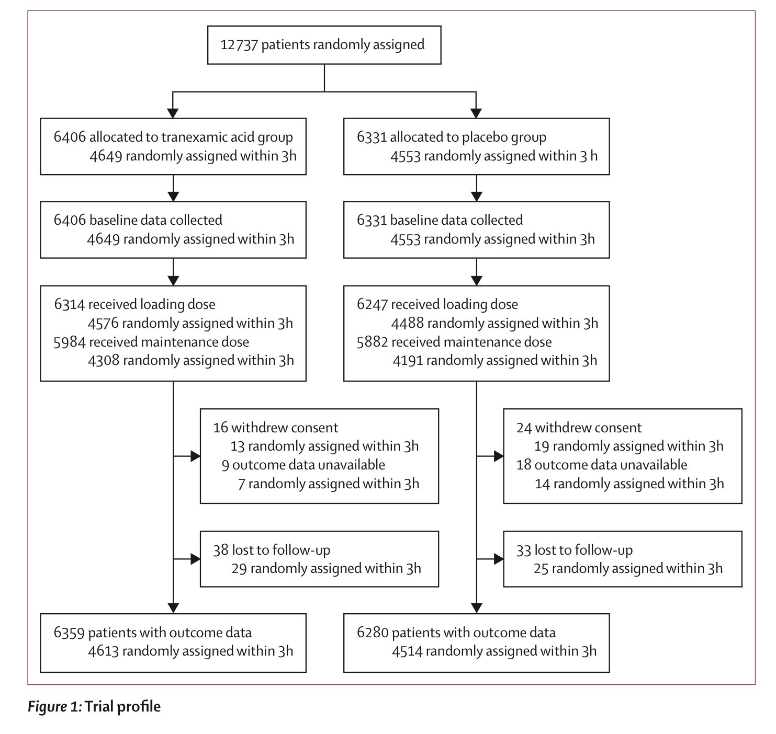
CRASH-3
Notes:
TBI w/I 3 h
GCS 12 หรือต่ำกว่า or ICH

Slide 27
CRASH-3

Slide 28
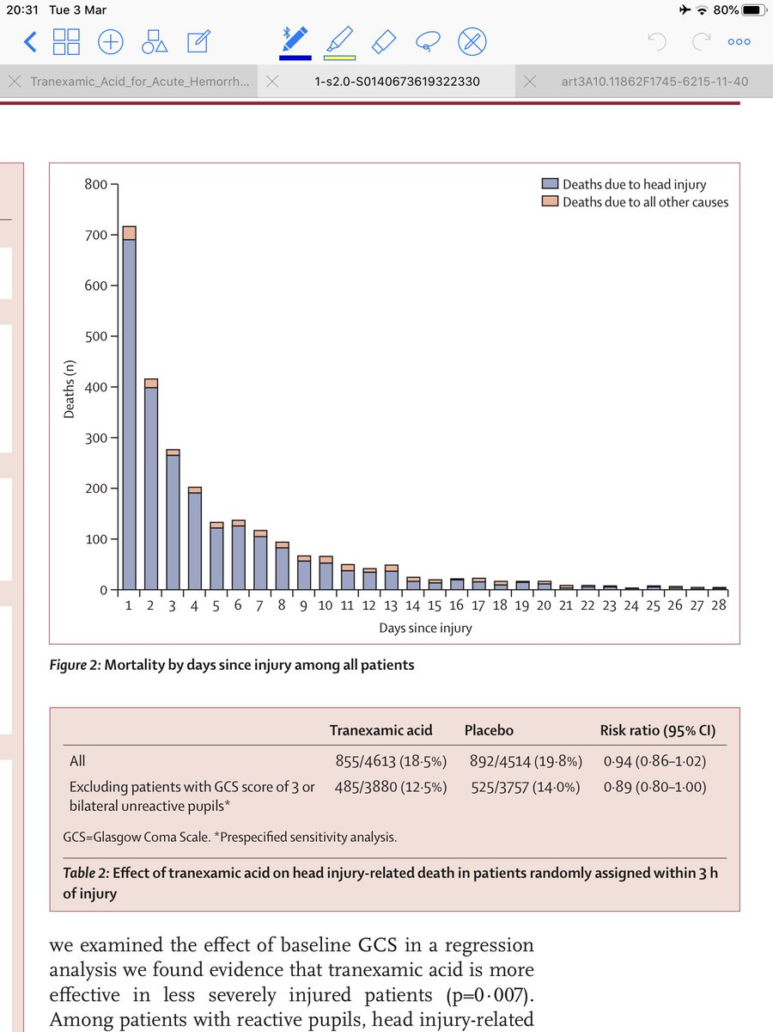
CRASH-3

Slide 29
CRASH-3

Slide 30
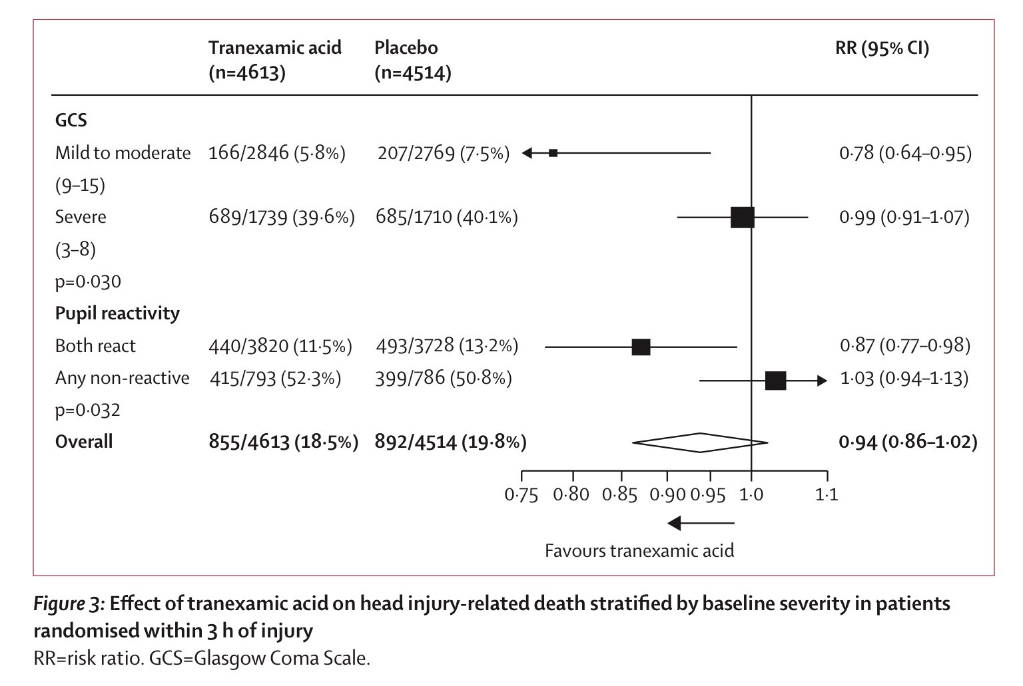
CRASH-3

Slide 31
CRASH-3

Slide 32
Pharmacokinetics
Dose: 1 g iv over 10 minutes, followed by iv infusion 1 g over 8 h
Unknown minimal therapeutic dose to inhibit fibrinolysis

Slide 33
Pathophysiology of traumatic coagulopathy
Trauma-induced coagulopathy
3 phenotypes of fibrinolytic response to massive trauma
-Hyperfibrinolysis 20%
-Physiologic fibrinolysis 20%
-Hypofibrinolysis 60%
Notes:
Hyper: life threatening, bleedingเยอะๆ แขนขาขาด
Hypo: TBI
Switch hyper เป็น hypo ได้ใน24ชม
Hypoเป็นhyper ไม่ค่อยเกิด

Slide 34
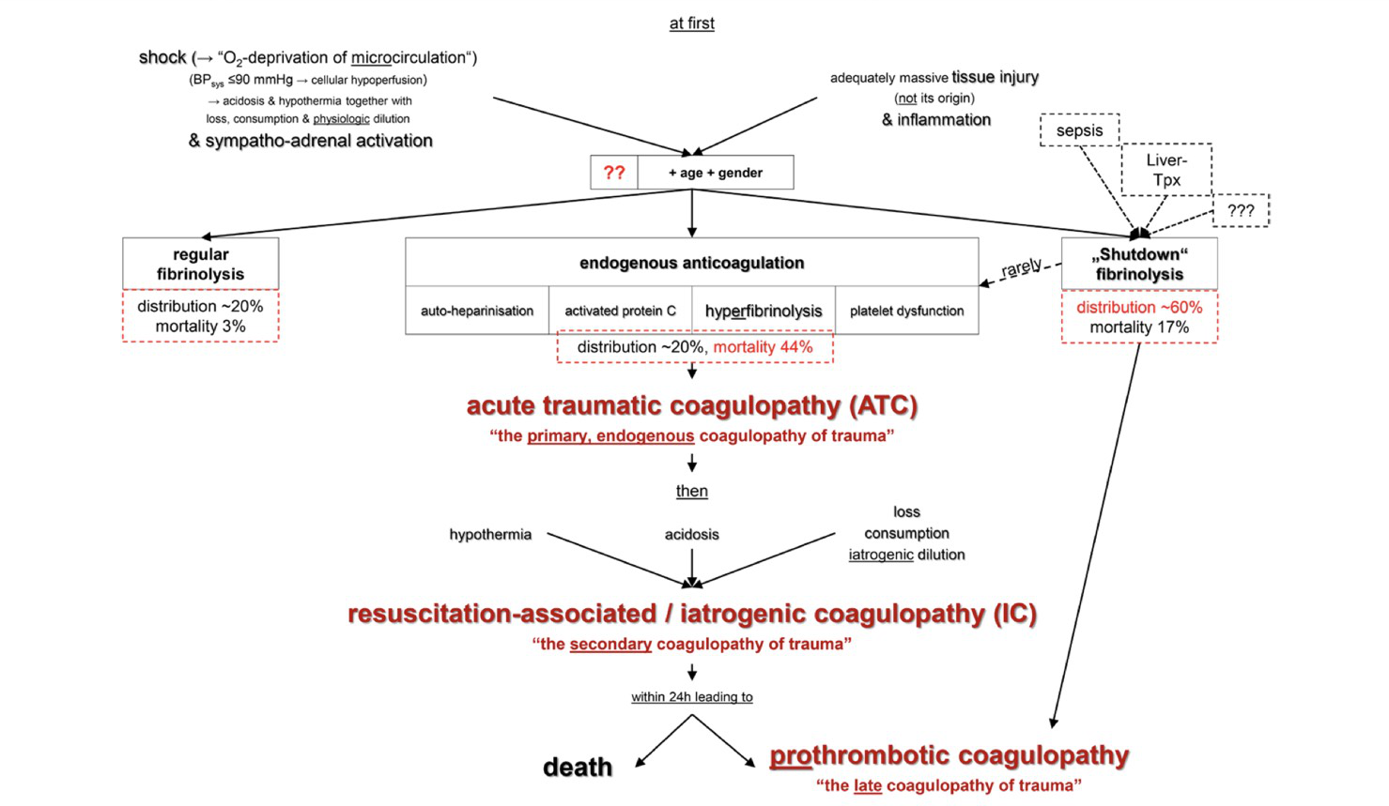

Slide 35
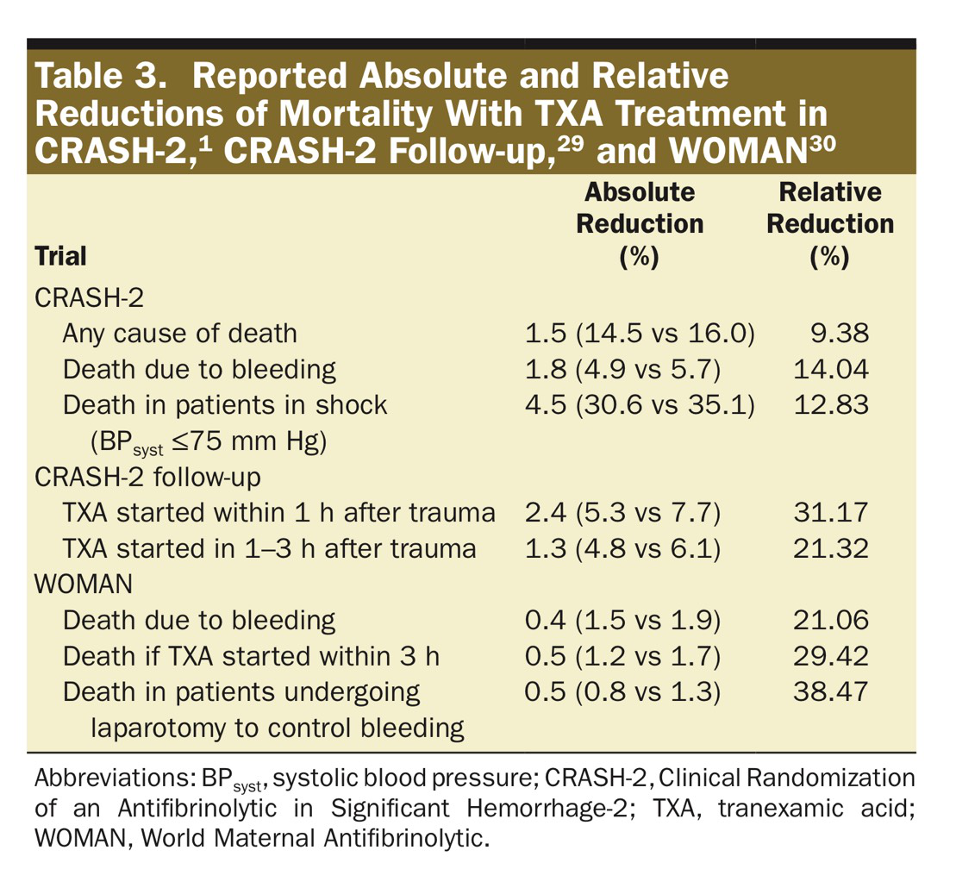

Slide 36
Thromboembolic Complications
Postoperative Liver transplantation: venous thromboembolism
CRASH-2: 369/20211 patients vascular occlusive events
168 in TXA group
201 in placebo group
MATTERs
9-fold increase for PE(0.3% without vs 2.7% with TXA)
12-fold increase for DVT(0.2% without vs 2.4% with TXA)

Slide 39
Thromboembolic Complications
“The possibility of increased VTE rates in patients with a previous history of thromboembolic events cannot be confidently excluded, and there is in sufficiency evidence on TXA safety in these patients to make definitive recommendations for use of antifibrinolytic therapy”

Slide 40
Conclusion
TXA is widely available, inexpensive, heat stable and cost-effectiveness
Effective in treating hyperfibrinolysis, component in blood management
Unknown: dose, kinetics, mechanism of action, clinical application and safety
Thromboembolic side effects

Slide 41
Conclusion
Indication
Treatment of severe life-threatening hemorrhage
Best before onset of shock
Within 3 hours of trauma and delivery
Bleeding cannot be stopped by other intervention measures(compression, TQ)

Slide 42
Take home message
Treatment of severe life-threatening hemorrhage
Dose: 1 g iv over 10 minutes, followed by iv infusion 1 g over 8 h
Give within 3 hours of trauma, surgery and PPH
Avoid in patient with previous history of thromboembolic event

